Slide 1
Provider Enrollment Workshop
Conduent
Government Healthcare Solutions

Slide 2
Purpose
The purpose of this workshop is to provide an overview of the enrollment process and maintenance of accurate provider records. Understanding these processes will improve the timeliness of obtaining and maintaining your active provider status with New Mexico Medicaid.

Slide 3
Objectives
We will review the following:
New Mexico Web Portal Information and Enhancements
Web Portal Application Submission Process
Application Tips
Return to Provider (RTP)
Turn Around Documents (TAD)
Update Requests

Slide 4
New Mexico Web Portal Information and Enhancements
Conduent
Government Healthcare Solutions

Slide 5
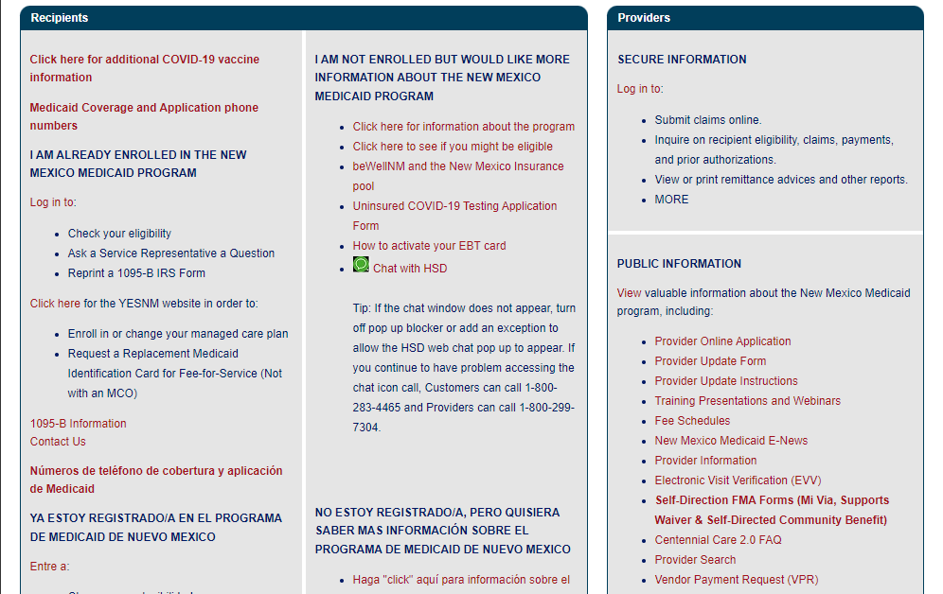
New Mexico Web Portal Information and Enhancements – Provider Search

Slide 6
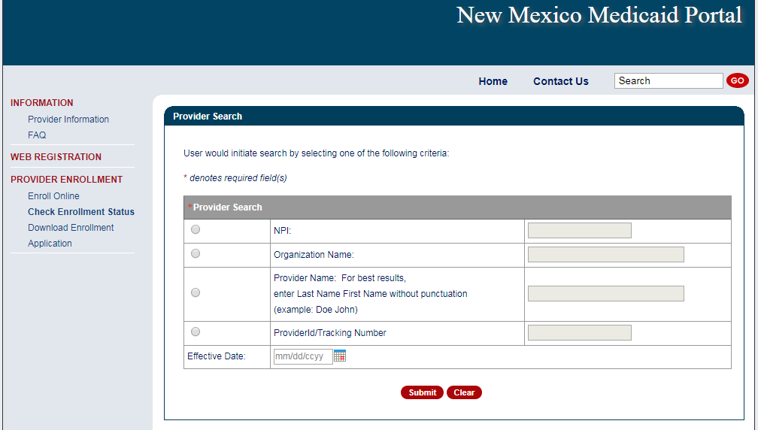
New Mexico Web Portal Information and Enhancements – Provider Search
Enter the provider NPI, Organization or Provider name, or Medicaid provider number to initiate search.
Notes:
Speaker Notes: New fields are
Provider ID/Tracking Number
User can enter either a Medicaid Provider ID or a Provider Enrollment Application Tracking Number
Effective Date
User can enter a specific date of service or leave the field blank
If date field is left blank, search will default to “today’s date” or the date the search is launched.
Results changes are:
Enrollment Status results will now include RTP and terminated status codes
Multiple results can appear simultaneously
Provider records without NPI will appear in the results

Slide 7
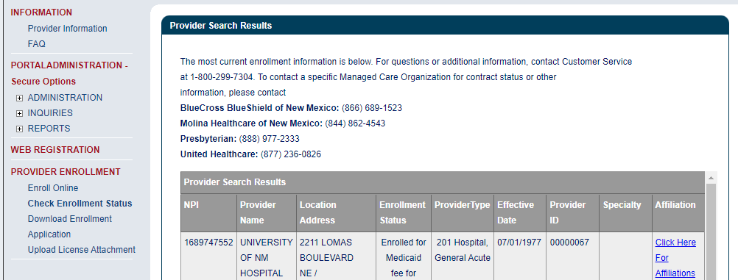
New Mexico Web Portal Information and Enhancements – Provider Search

Slide 8
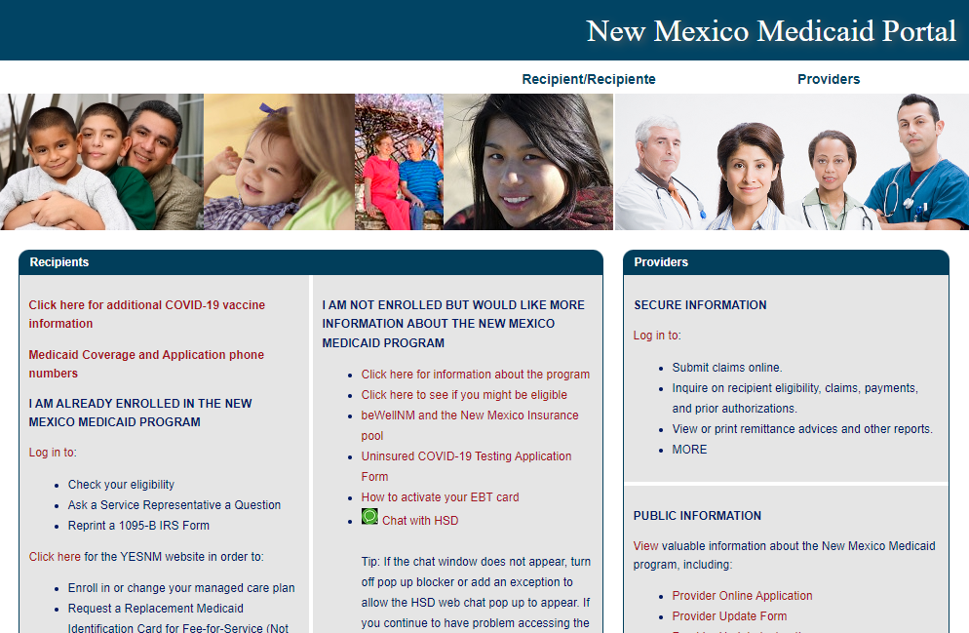
New Mexico Web Portal Information and Enhancements – Enrollment Status
Notes:
Speaker Note: Users can also access Provider Search from the Check Enrollment Status option.

Slide 9
New Mexico Web Portal Information and Enhancements – Enrollment Status
Notes:
Speaker Notes: New fields are
Provider ID/Tracking Number
User can enter either a Medicaid Provider ID or a Provider Enrollment Application Tracking Number
Effective Date
User can enter a specific date of service or leave the field blank
If date field is left blank, search will default to “today’s date” or the date the search is launched.
Results changes are:
Enrollment Status results will now include RTP and terminated status codes
Multiple results can appear simultaneously
Provider records without NPI will appear in the results

Slide 10
New Mexico Web Portal Information and Enhancements – Enrollment Status
Notes:
Check Enrollment Status gives the same information as a Provider Search.

Slide 11
Web Portal Application Submission Process
Conduent
Government Healthcare Solutions

Slide 12
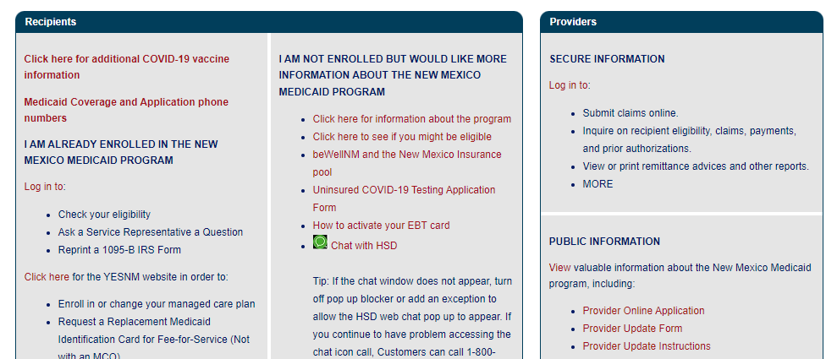
NM Medicaid Web Portal Application Location
https://nmmedicaid.portal.conduent.com/webportal/enrollOnline

Slide 13
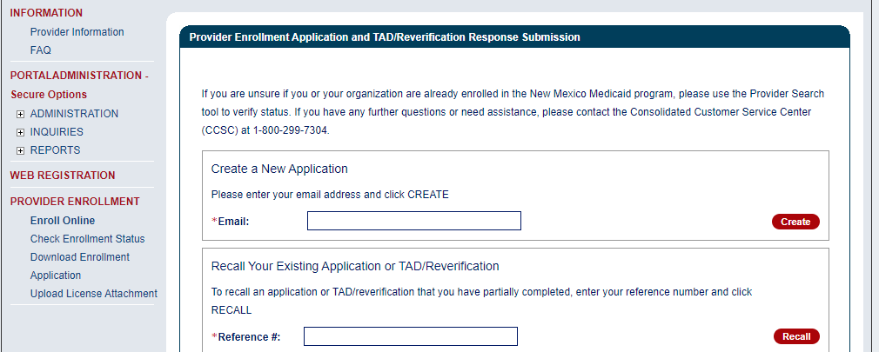
Provider Enrollment Application Initial Screen

Slide 14
Provider Enrollment Application Initial Screen
Begin your application by entering your email address.

Slide 15
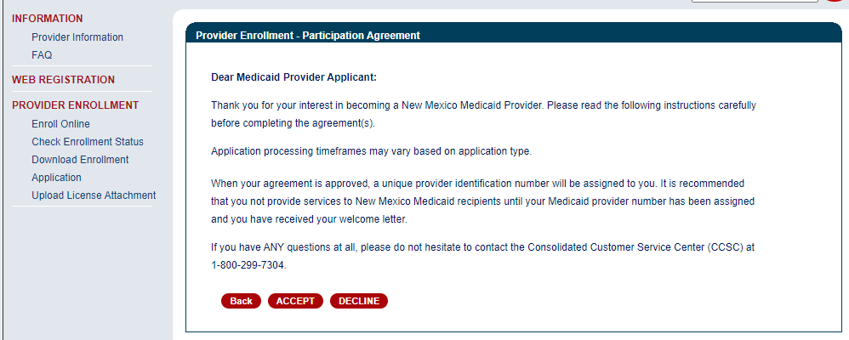
Provider Participation Agreement (Application)

Slide 16
Selecting the Right Application Form
MAD 335 - Medicaid Provider Participation Agreement for groups, organizations, facilities, or individual applicants to whom payments will be made (including CSAs, FQHCs, Hospitals, Pharmacies, etc.)
MAD 312 - Medicaid Provider Participation Agreement for individual applicant within group (including Psychologists, MDs, CNPs, LCSWs, LMHCs, etc.)
Please review the Provider Type and Specialty List for a complete list of documents that must be included with the Application, as well as applicable enrollment restrictions

Slide 17
Web Portal Application Submission Process – MAD 312
Conduent
Government Healthcare Solutions

Slide 18
Web Portal Application Submission Process – MAD 312
MAD 312 applications are used to enroll individuals who perform services within a group or organization
Select either:
Fee-For-Service (FFS) and Managed Care Organization (MCO) network or Fee-For-Service (FFS) only.
Managed Care Organization (MCO) Only
Click on “initial enrollment” and “continue”

Slide 19
Web Portal Application Submission Process – MAD 312

Slide 20
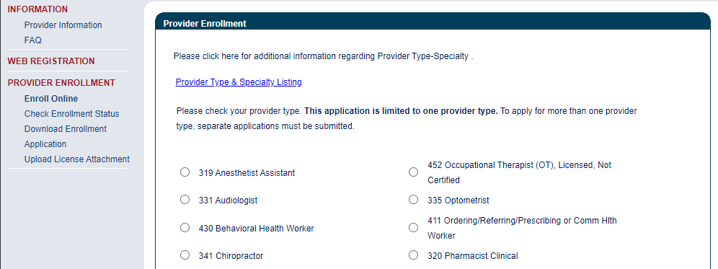
Web Portal Application Submission Process – MAD 312
Choosing a provider type: Use the Provider Type & Specialty Listing link to view your provider type and the required documentation associated with that provider type.

Slide 21
Provider Type & Specialty List

Slide 22
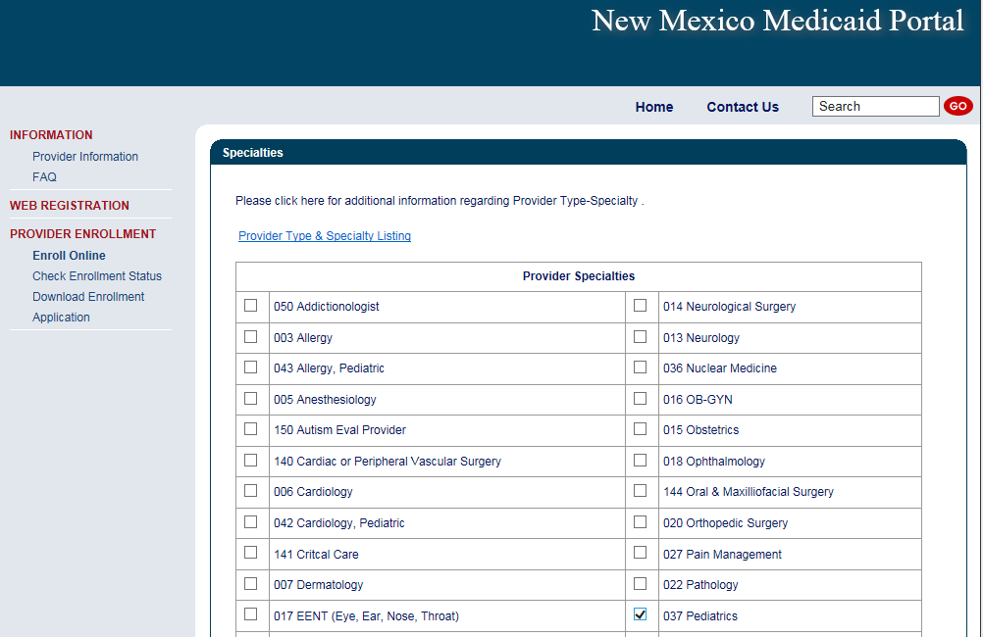
Web Portal Application Submission Process – MAD 312
Click on the specialty being requested. Note: not all provider types require a specialty.

Slide 23
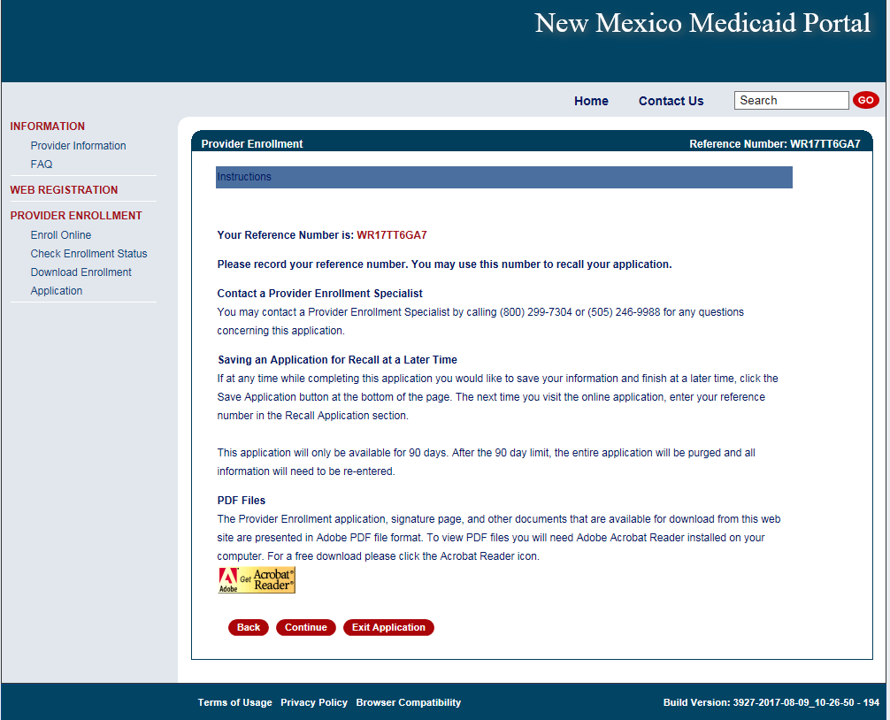
Web Portal Application Submission Process – MAD 312
Please note your Reference Number. This will be the number you use to retrieve the application later.

Slide 24
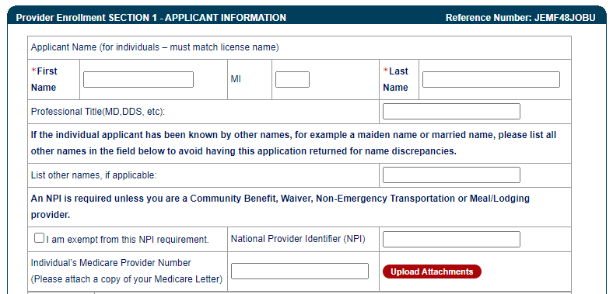
Web Portal Application Submission Process – MAD 312
The provider’s name, NPI, and Medicare Number (if applicable) are entered here.

Slide 25
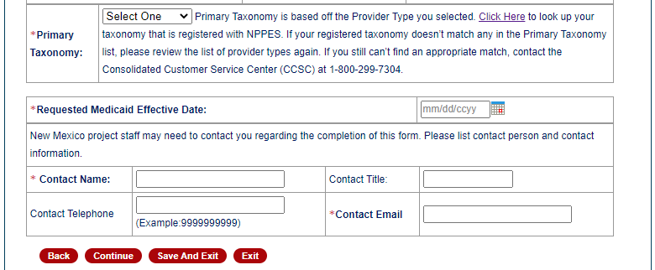
Web Portal Application Submission Process – MAD 312
The primary Taxonomy, effective date (cannot be a future date), and contact information are entered here.

Slide 26
Web Portal Application Submission Process – MAD 312
Enter Social Security Number and Date of Birth.

Slide 27
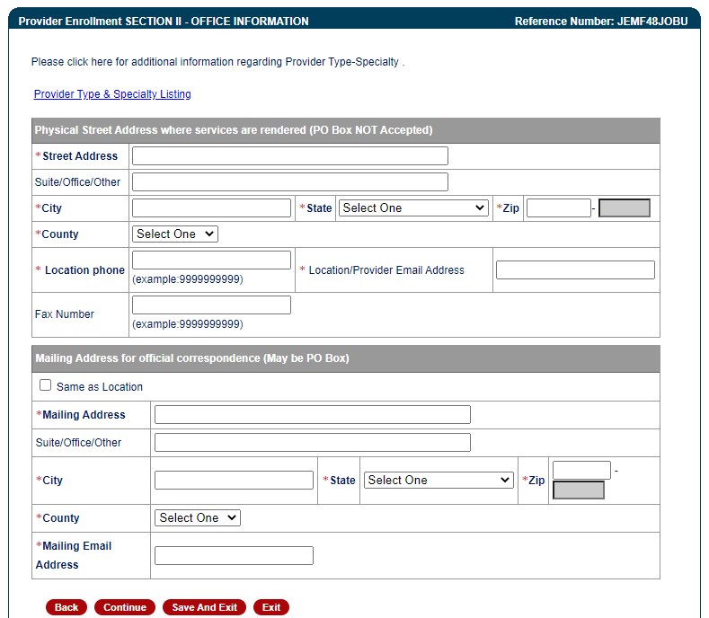
Web Portal Application Submission Process – MAD 312
Practice location address and mailing address are both required

Slide 28
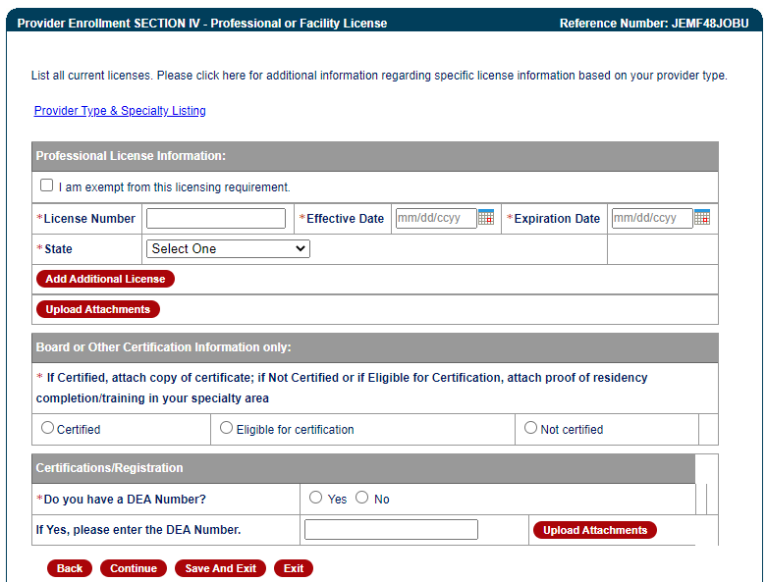
Web Portal Application Submission Process – MAD 312
The State issuing the professional license and the State in which the provider is practicing must match (except for providers affiliating with IHS) Note: Telemedicine providers should submit the professional license from their home state (not Telemedicine license alone).
Notes:
Mention certification website for providers to get effective dates for providers only to obtain.

Slide 29
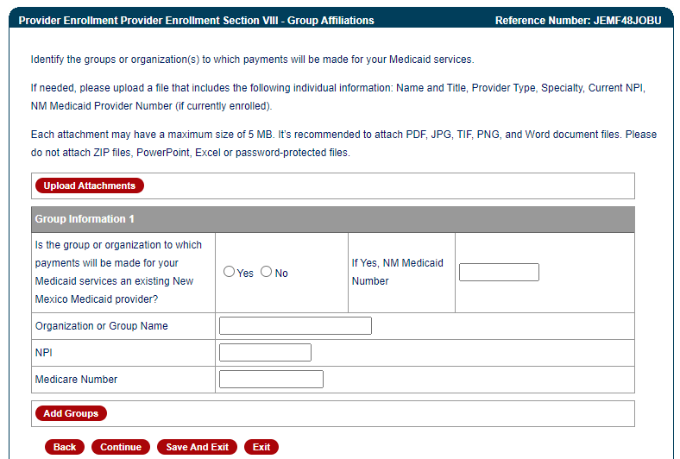
Web Portal Application Submission Process – MAD 312
Enter billing group information.

Slide 30
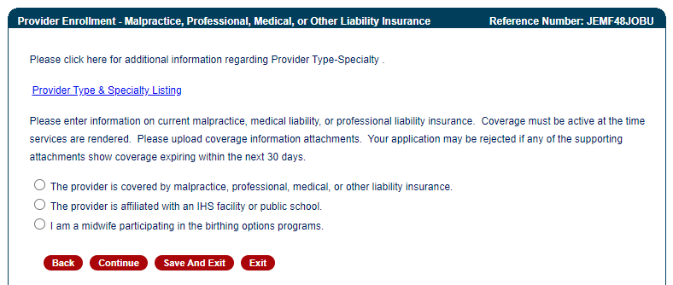
Web Portal Application Submission Process – MAD 312
Select type of professional liability insurance coverage.
Notes:
If you are a midwife participating in the birthing options program be sure to also submit supplemental agreement and affidavit of insurance.

Slide 31
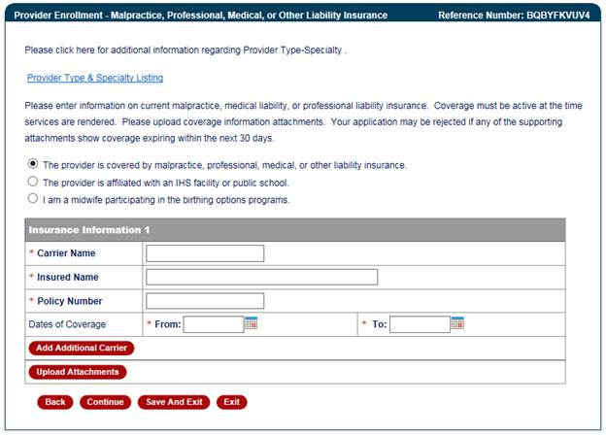
Web Portal Application Submission Process – MAD 312
If selecting liability insurance, enter policy and date information and attach documentation.

Slide 32
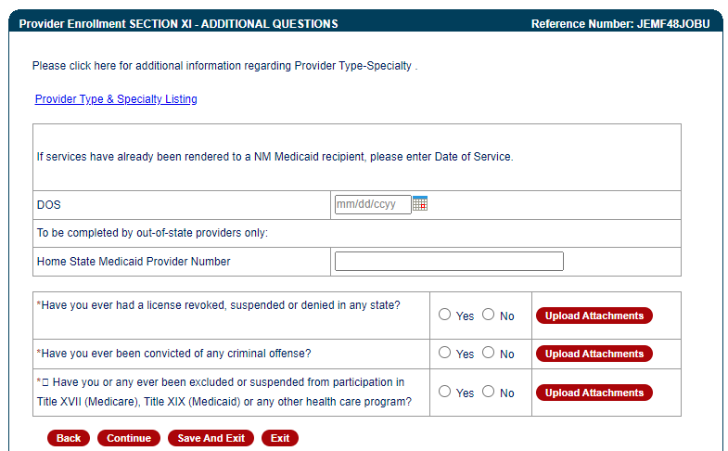
Web Portal Application Submission Process – MAD 312
Answer additional questions and attach documentation if applicable.

Slide 33
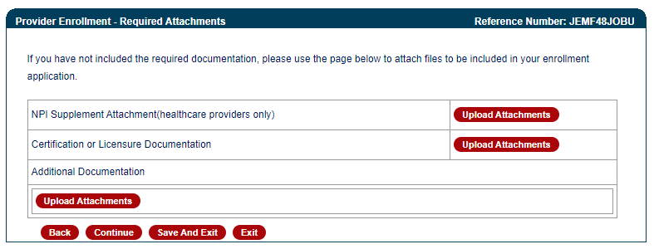
Web Portal Application Submission Process – MAD 312
Attach remaining required documentation if applicable.

Slide 34
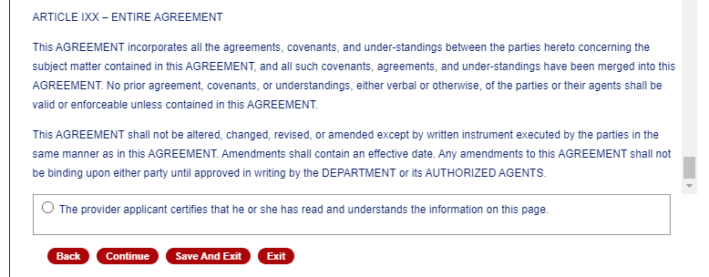
Web Portal Application Submission Process – MAD 312
Read and certify the provider agreement.

Slide 35
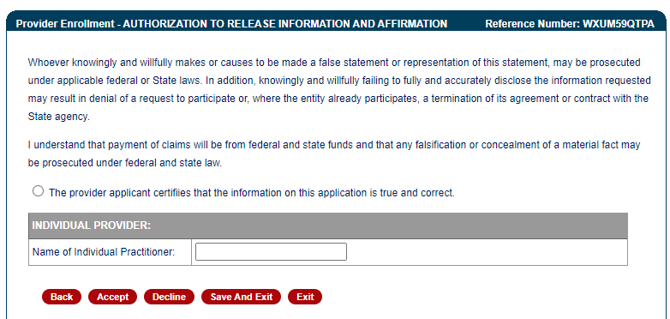
Web Portal Application Submission Process – MAD 312
Read and certify the Authorization to Release Information.

Slide 36
Web Portal Application Submission Process – MAD 312
Click Submit to complete the application process.

Slide 37
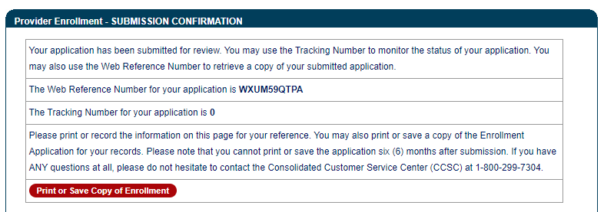
Web Portal Application Submission Process – MAD 312
Record the Web Reference Number and Tracking Number and save or print the application.

Slide 38
Turquoise Care Managed Care Organizations (MCOs)
Reminder: Claims for recipients who are enrolled in Turquoise Care are submitted directly to the Managed Care Organization they are enrolled with. Following is the contact information for those MCOs.
Turquoise Care MCOs | Contact Number | Website
BlueCross BlueShield of New Mexico | (866) 689-1523 | www.bcbsnm.com/turquoise-care
Molina Healthcare | (844) 862-4543 | https://www.molinahealthcare.com/members/nm/en-US/pages/home.aspx
Presbyterian | (888) 977-2333 | http://www.phs.org/health-plans/turquoise-care-medicaid
United Healthcare Community Plan of NM | (877) 236-0826 | https://www.uhc.com/communityplan/new-mexico/plans

Slide 39
Web Portal Application Submission Process – MAD 335
Conduent
Government Healthcare Solutions

Slide 40
Web Portal Application Submission Process – MAD 335
MAD 335 applications are used to enroll providers to whom payment will be made
Select either:
Fee-For-Service (FFS) and Managed Care Organization (MCO) network or Fee-For-Service (FFS) only.
Managed Care Organization (MCO) Only
Click on “initial enrollment” and “continue”

Slide 41
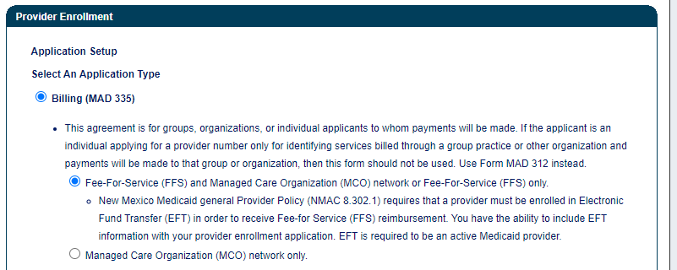
Web Portal Application Submission Process – MAD 335

Slide 42
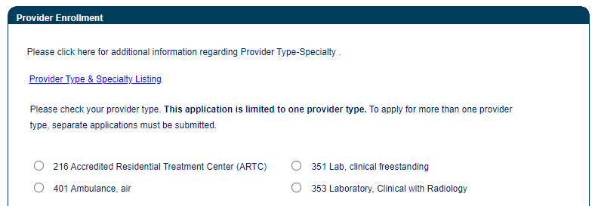
Web Portal Application Submission Process – MAD 335
Choosing a provider type: Use the Provider Type & Specialty Listing link to view your provider type and the required documentation associated with that provider type. Select Individual or Group provider.

Slide 43
Provider Type & Specialty List

Slide 44
Web Portal Application Submission Process – MAD 335
Click on the specialty being requested. Note: not all provider types require a specialty.

Slide 45
Web Portal Application Submission Process – MAD 335
Take note of your Reference Number. This will be the number you use to retrieve the application later.

Slide 46
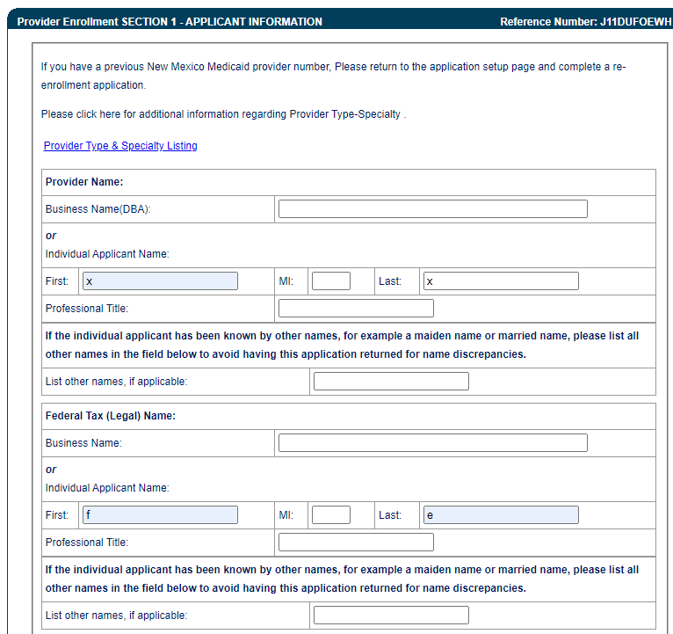
Web Portal Application Submission Process – MAD 335
The provider’s business name or individual name are entered here.

Slide 47
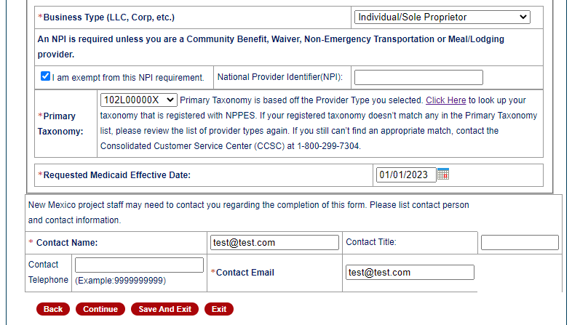
Web Portal Application Submission Process – MAD 335
The business type, NPI, primary taxonomy, Medicaid effective date, and contact information are entered here.
Note: Type 1 NPIs are assigned to individual providers, and Type 2 NPIs are assigned to organizational providers

Slide 48
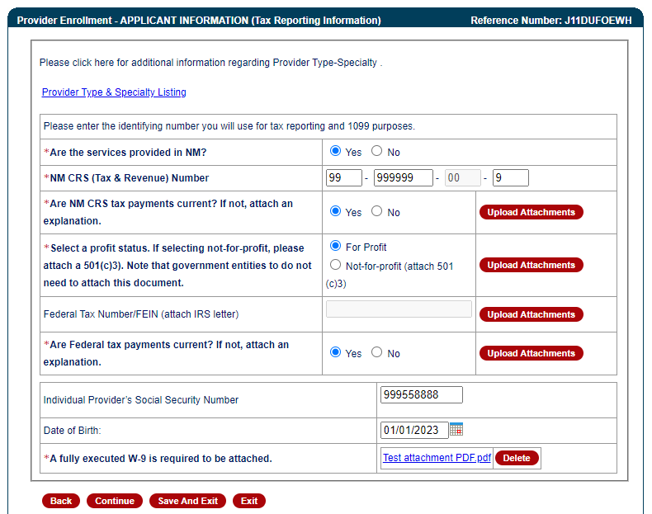
Web Portal Application Submission Process – MAD 335
If services are provided in NM, a CRS (Tax and Revenue) number is needed. Enter either a Federal Tax Number or Social Security Number. Upload all necessary attachments.

Slide 49
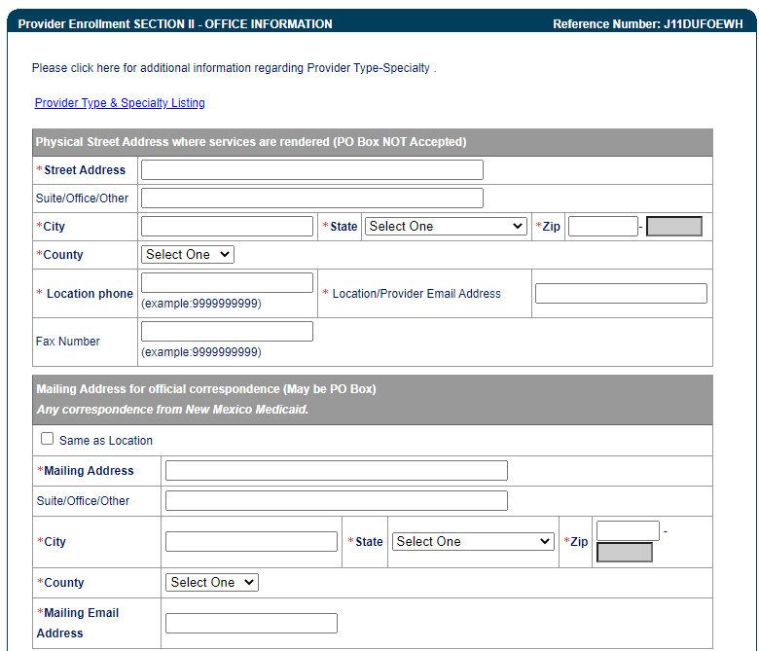
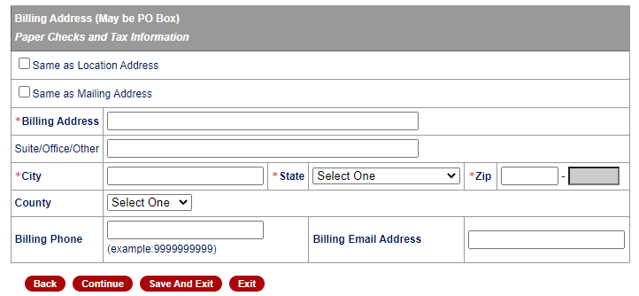
Web Portal Application Submission Process – MAD 335
Practice location address, mailing and billing address are required

Slide 50
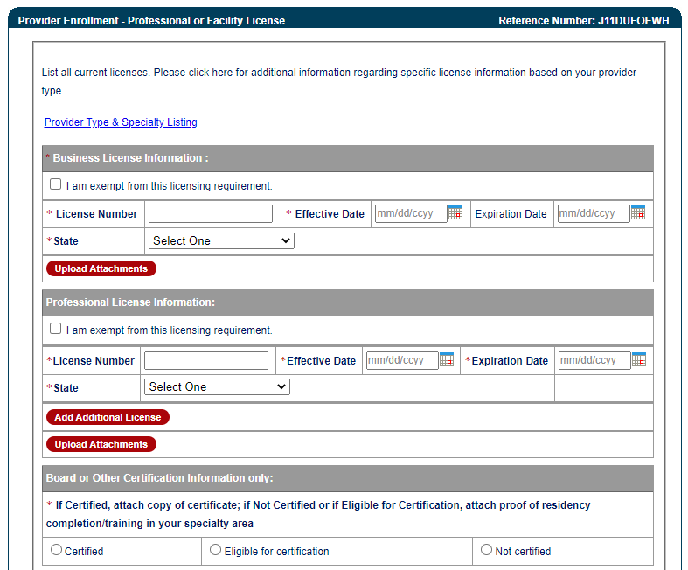
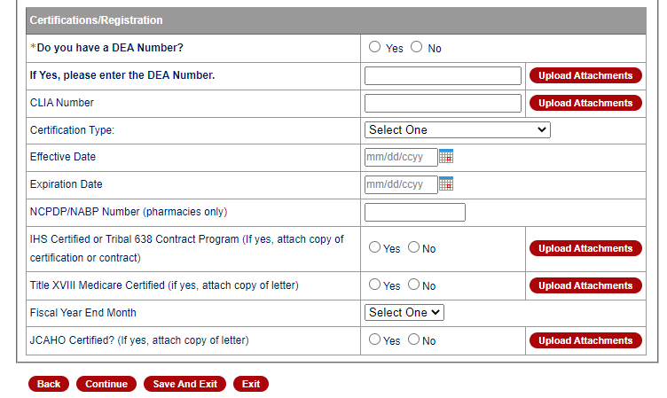
Web Portal Application Submission Process – MAD 335
Enter current license information and upload necessary documents.

Slide 51
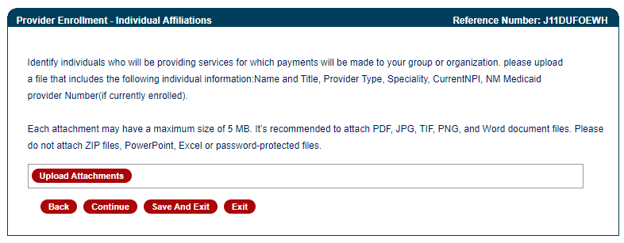
Web Portal Application Submission Process – MAD 335
Upload documentation on all providers that will be rendering services for your group.

Slide 52
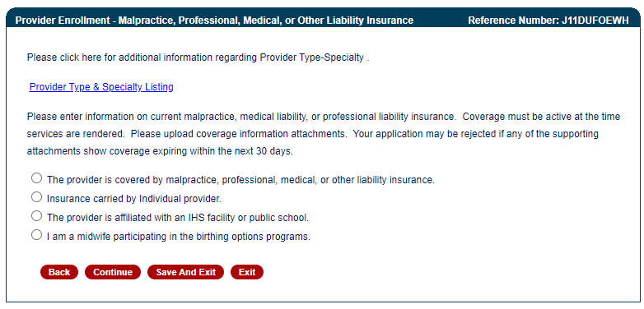
Web Portal Application Submission Process – MAD 335
Select type of professional liability insurance coverage.
Notes:
If you are a midwife participating in the birthing options program be sure to also submit supplemental agreement and affidavit of insurance.

Slide 53
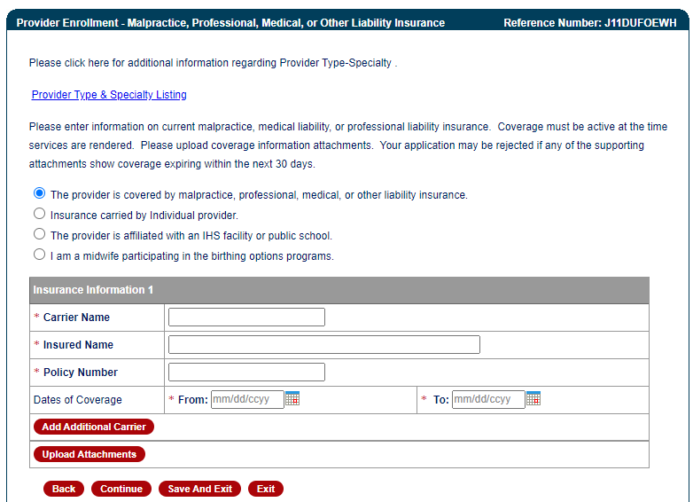
Web Portal Application Submission Process – MAD 335
If selecting liability insurance, enter policy and date information and attach documentation.

Slide 54
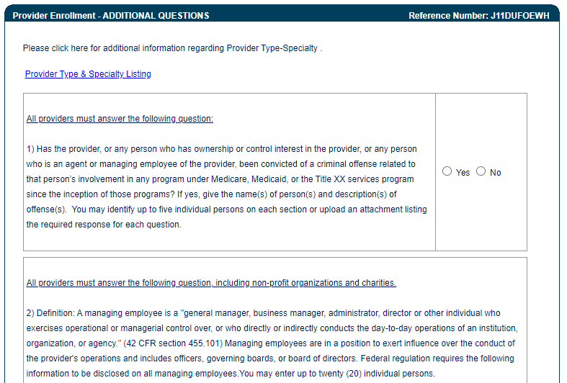
Web Portal Application Submission Process – MAD 335
Answer additional questions and attach documentation if applicable.

Slide 55
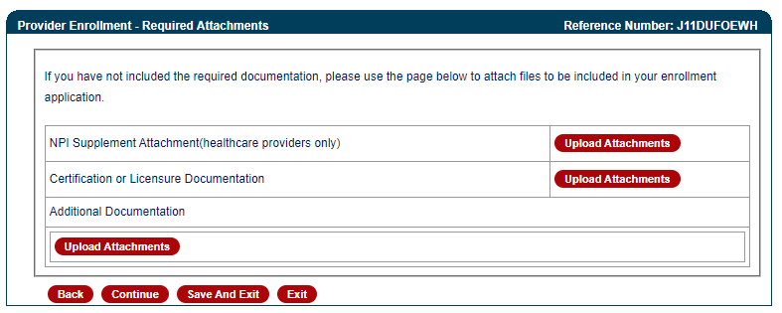
Web Portal Application Submission Process – MAD 335
Attach remaining required documentation if applicable.

Slide 56
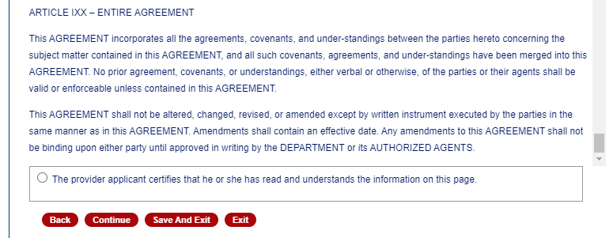
Web Portal Application Submission Process – MAD 335
Read and certify the provider agreement.

Slide 57
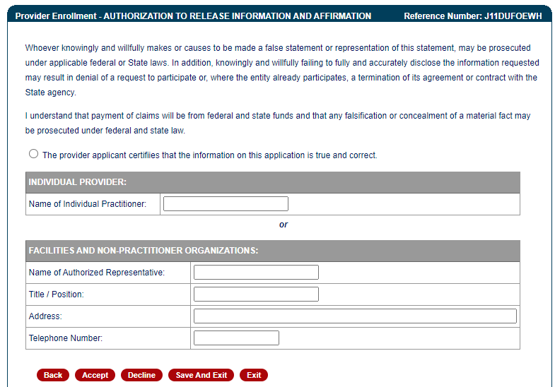
Web Portal Application Submission Process – MAD 335
Read and certify the authorization to release information.

Slide 58
Web Portal Application Submission Process – MAD 335
Click Submit to complete the application process.

Slide 59
Web Portal Application Submission Process – MAD 335
Record the Web Reference Number and Tracking Number and save or print the application.

Slide 60
Application Tips
Conduent
Government Healthcare Solutions

Slide 61
Provider Enrollment Application Screen
Recall Your Existing Application: If you saved an application but did not submit it, you have 90 days to recall the application and submit it.
Enter the application reference number to recall the application.
If you do not have the reference number, enter your provider email on file and submit. The reference number will be sent to the email address.

Slide 62
Top Errors on Provider Enrollment Applications
Expired License or Insurance Policy
Tip: To ensure processing is not delayed, validate that the license or Certificate of Insurance (COI) expiration date is greater than 30 calendar days from the day Conduent receives your application.
Incorrect National Provider Identification Number (NPI)
Note: Applications using a Social Security Number (SSN) need a Type 1 NPI, and applications using a Federal Employer Identification Number (FEIN) need a Type 2 NPI.
Tip: We recommend visiting the National Plan and Provider Enumeration System (NPPES) website to ensure the correct NPI is submitted. The NPPES website is https://npiregistry.cms.hhs.gov/
Notes:
Disclosure notice – a pending application does not guarantee activation.

Slide 63
Top Errors on Provider Enrollment Applications Continued
Incomplete or Missing Information – IRS Letter/W-9 or Approval Letters
Tip: We recommend you refer to the Provider Type and Specialty List before submitting your application in order to review the required attachments for your specific provider type.

Slide 64
Return to Provider
Conduent
Government Healthcare Solutions

Slide 65
Return to Provider
If an application contains errors and/or missing/incorrect documentation, the provider will receive timely notification (via email) detailing the corrections needed before resubmitting the complete application to Conduent for review.
This process is referred to as “Return to Provider” (RTP).

Slide 66
Return to Provider
To resubmit your returned application, enter the application reference number in the Reopen and Resubmit box and click Reopen. You have 6 months to submit a corrected application.

Slide 67
Return to Provider
If an application that was returned to the provider is reopened but not resubmitted during that session, the application can then be opened using the Recall option. The application must be resubmitted within 90 days of being reopened.

Slide 68
Turn Around Document (TAD)
Conduent
Government Healthcare Solutions

Slide 69
Turn Around Document (TAD)
The purpose of the Turn Around Document (TAD) is to verify that the provider information on file is current.
TADs are issued to all enrolled providers every three years.
A total of five TADs are issued (if necessary) according to the following schedule:
Two months prior to the renewal date (1st & 2nd notices)
Renewal month (3rd notice)
One month after the renewal date (4th notice)
Two months after the renewal date (5th notice)
If the provider fails to submit a completed TAD in response to at least one of the notices, the provider file will be terminated for no re-verification.
Notes:
Please respond promptly. If at all possible, reply to the 1st or 2nd notice to allow enough time for processing the request prior to your re-verification period expiring. Consider the 3rd – 5th notices as final warnings. The processing times for TADs is 5 business days.
After termination for non-response, provider may have to submit a new application.
If you have any questions or issues please contact the Conduent Provider Relations Call Center – (800) 299 - 7304 option 6 or (505) 246 - 0710 option 6

Slide 70
Turn Around Document (TAD)
Common Errors on TADs:
Altering a document to match a different person/business - The TAD belongs to the person/business it is printed for and is identified by the provider number/NPI.
Using white out or line out - If a correction is required, strike a line through it and initial next to the correction.
Missing or invalid signature - Signature must be in blue ink.
Missing initials - The three disclosure questions require initials.
Faxing in a TAD - Faxes are not accepted. Only hard copies with original signature will be processed.

Slide 71
Update Requests
Conduent
Government Healthcare Solutions

Slide 72
Update Requests
Providers may need to update demographic information after enrollment such as:
Change of address
Add or change an email or phone number
Add an NPI
Update licenses and certifications, affiliations, or enrollment status
Submit an update request form in the event of a change of ownership (NPI/Tax ID changes, sale or corporate restructure).
Provider Enrollment will contact the requestor if further information is needed.
Notes:
The processing times for updates is 5 business days.
If you have any questions or issues please contact the Conduent Provider Relations Call Center – (800) 299 - 7304 option 6 or (505) 246 - 0710 option 6

Slide 73
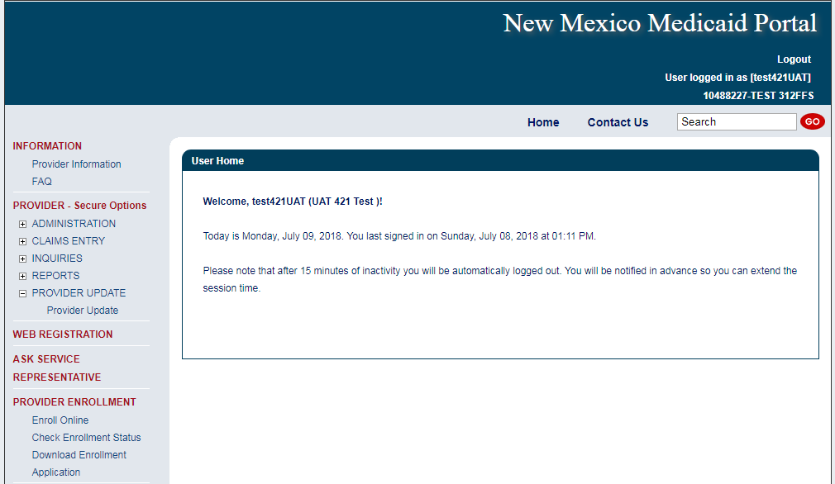
Update Requests - Online
Provider updates may be requested on the web portal. In the secure option menu, click on Provider Update.

Slide 74
Update Requests - Online
Select the provider number to update or enter the provider NPI or ID to update an alternate provider.

Slide 75
Update Requests - Online
Click on the type of information to open the update form, enter the new information, and submit.
This process is detailed in the Online Provider Update Overview workshop from Conduent. Please see the webinar schedule.

Slide 76
Update Requests
Common Errors on Updates:
Submitting an application to cross reference an active provider to a group - An update form, rather than an application, should be submitted for cross referencing active providers. Conduent encourages providers to use the Provider Search function on the web portal to verify that the provider is active.
Missing Provider information - Include provider numbers or NPIs on all correspondence.

Slide 77
New Mexico Medicaid Resources
New Mexico Medicaid Online
Provider Information
Provider Login Screen Notices
Provider E-News Newsletters
Medicaid Provider Relations Call Center
Provider Communication Updates
Provider Field Representative
Provider Webinars
Open Forums and Live Training Sessions
Continued on next page . . .

Slide 78
New Mexico Medicaid Resources Continued
New Mexico Medicaid Portal – https://nmmedicaid.portal.conduent.com/static/index.htm
Claim Inquiries, Eligibility Verification, Electronic Claim Submission, Provider Manuals, E-News
NM Human Services Department – http://www.hsd.state.nm.us/mad/
Supplements, Memos, Provider Billing Packets and Policy
Medical Assistance Division – PE Program Staff – HSD.PEDeterminers@state.nm.us
Assistance with PE Applications, PE Determinations, MAD 070, PE Training, PE Certification
Consolidated Customer Service Call Center – (800) 299 - 7304
Claim Status, Eligibility, Prior Authorization, Medicaid Updates
Conduent Provider Relations Helpdesk – NMProviderSUPPORT@conduent.com
Claim research assistance and general Medicaid inquiries
Conduent HIPAA Helpdesk – HIPAA.DeskNM@hsd.nm.gov Assistance on NM Web Portal, EDI inquiries, and Online Claim Submission with DDE (Direct Data Entry)
Conduent Provider Enrollment Helpdesk - NMProviderSUPPORT@conduent.com
Provider Enrollment Applications, Forms & Instructions
Medical Assistance Division, Program Rules – http://www.hsd.state.nm.us/providers/rules-nm-administrative-code-.aspx
NMAC for Programs administered by the Medical Assistance Division Yes New Mexico - https://www.yes.state.nm.us/yesnm/home/index Apply, check, update, or renew Medical Assistance (Medicaid) benefits

